Slide 1
Context Sensitive Systems
Part 2: History of Context Awareness
SS 2016
teco.kit.edu, pcs.tm.kit.edu

Slide 2
Recap: Context optimizes!
Context
can be used in different meanings.
is typically different from content (ie. Meta-Information, Situation/Environment)
In human communication, situational info is implicit, to increase the conversational bandwidth
Goal: Make interaction with computer systems more efficient
The limiting factor of IT is often not processor speed or memory size, but limits of human attention.
Especially in mobile computing, situation changes frequently and the user is preoccupied with other tasks

Slide 3
Feedback last lecture:
Room to small !?
Integrate practical aspects:
R-Studio?
…

Slide 4
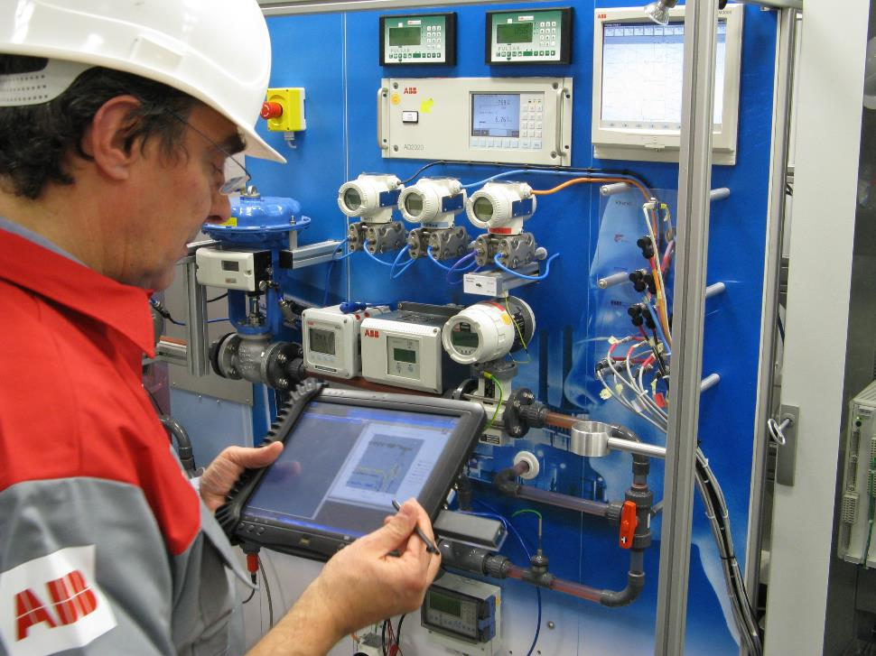
teco.kit.edu Industrie 4.0
Context Aware Maintenance

Slide 5
Core Definition by Schilit et al., 1994
One challenge of mobile distributed computing is to exploit the changing environment with a new class of applications that are aware of the context in which they are in.
Such context-aware systems adapts according to the location of use, the collection of nearby people, hosts, and accessible devices, as well as to changes to such things over time.
A system with these capabilities can examine the computing environment and react to changes to the environment

Slide 6
Definition by Chen/Kotz: Acive vs. Passive
Context is the set of environmental states and settings that
either determines an application's behavior (active context = critical)
or in which an application event occurs and is interesting to the user (passive context = relevant)

Slide 7
Definition by Dey/Abowd: Primary vs Secondary
"Context is any information that can be used to characterize the situation of an entity. An entity is a person, place, or object that is considered relevant to the interaction between a user and an application, including the user and applications themselves“
primary context (location - where, identity - who, time - when, activity - what)
secondary context (anything that can be found on the basis of the primary context)
“A system is context-aware if it uses context to provide relevant information and/or services to the user, where relevancy depends on the user's task"

Slide 8
Different aspects of context
3 important aspects of context according to Schilit et. al:
Where are you?
Who are you with?
What resources are nearby?
4 dimensions of context (Gross and Specht [2001]) :
Location
Identity (user’s interests, preferences, knowledge and activity logs)
Time (e.g. working hours)
Environment or activity

Slide 9
teco.kit.edu Industrie 4.0
More types of Context?

Slide 10
More common aspects to context
Geographical (e.g. country, street, building, floor, office)
Physical (e.g. lighting, noise level, temperature, acceleration,tilt)
Organisational (e.g. institution, department, group, project)
Social (e.g. family, friend, co-worker, married, single)
Emotional (e.g. heart rate, skin conductance)
User (e.g. profile, location, capabilities, role, access rights)
Task (e.g. documenting, programming, building a house)
Action (e.g. typing, reading, walking, sitting, talking)
Technological (e.g. connectivity, network bandwidth, network latency)
Time (e.g. time of day, weekday, week, month, season)
[Mayrhofer, 2004]

Slide 11
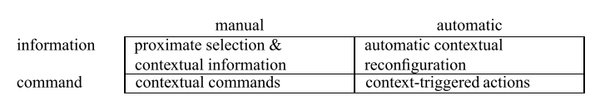
Classes of context-sensitive applications
Dimension 1: Is the adaption done automatic or manual?
Dimension 2: Does the application adapt information access or perform actions?
Task: Two Examples per Class: 10 min break!
Trigger
Output
Manual /explicit
automatic/implicit
Information access
Command execution

Slide 12
Examples

Slide 13
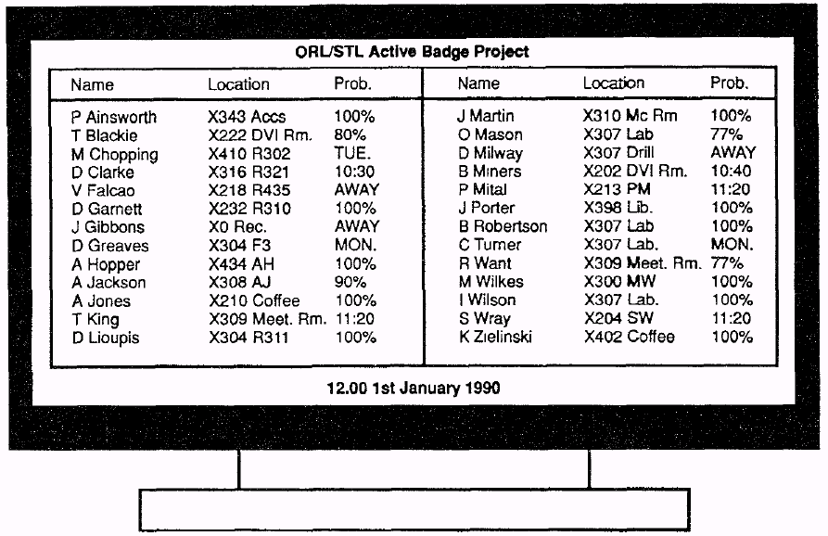
Olivetti Active Badges
Problem: locating researchers
Solution: badge tied to identity, tracked as researcher moves in building
[Want and Hopper, 1992]
Assistant sees this view
- knows where researcher is
- can forward call
Notes:
Alternative solution: have researchers update their location whenever they move
- annoying, and unreliable

Slide 14
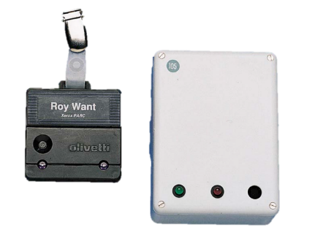
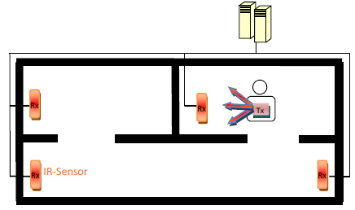
Active Badge Hardware

Slide 15
Goal [Dey and Abowd, 2000]
Apps like Active Badges using specific user context (e.g. location) as application input
Need representation of context
Helps to build context-aware applications
better embedded in the UbiComp and mobile realms

Slide 16
Operational Definition of Context
“Context is any information that can be used to characterize the situation of an entity. An entity is a person, place, or object that is considered relevant to the interaction between a user and an application, including the user and the application themselves.” [Dey and Abowd, 2000]
Observations
From point of view of developer
Notes:
Does this definition make sense outside of computer science/context-aware application design?
What if there’s no application? Does context disappear?

Slide 17
Active Badges
Application: help operator forward calls to researcher at appropriate location
Entity | Characteristic Info (context)
Researcher | Badge ID/Name, location, ?Time of the workday (morning, lunch, dinner)?
Room | Presence of a phone
Notes:
Notice that we don’t include the operator

Slide 18

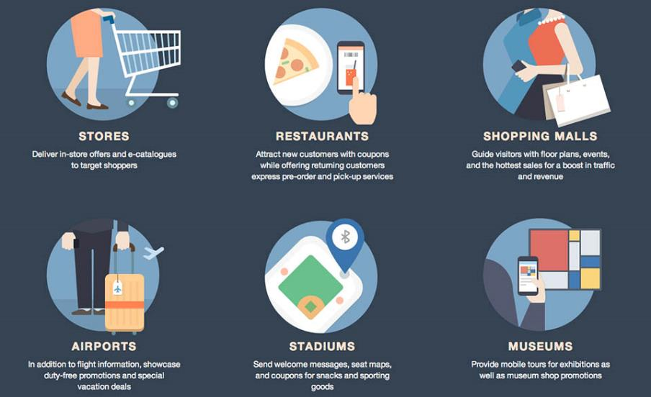
Beacon based context today

Slide 19
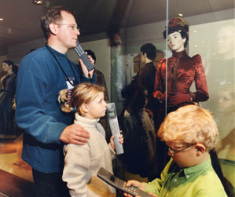
What’s the Context?
Context:
Notes:
Museum location, identity of individuals (children vs adults), exhibit, the listening devices, the activity (browsing a museum). Does when matter?

Slide 20
Museum Audio Guide Example
Application: digital museum guide
Entity | Characteristic Info (context)
Exhibition item

Slide 21
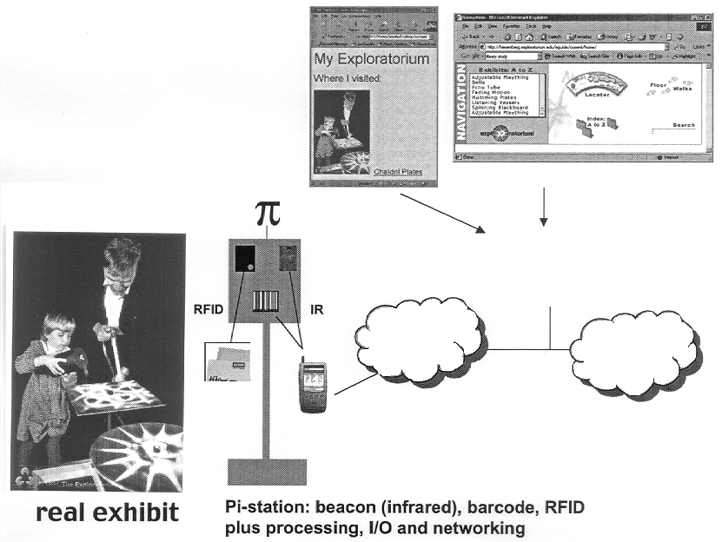
HP Cooltown: The electronic guidebook,2002

Slide 22
Context-Aware Applications
“A system is context-aware if it uses context to provide relevant information and/or services to the user, where relevancy depends on the user’s task.”
Contextual Information
Find photos by location metadata
Presentation of information and services
Switch phone to vibration in Meeting,
Contextual Commands
Location aware interface elements in tour guide
Contextually triggered Actions
Presence based home automation

Slide 23
Context Toolkit [Salber et al, 1999]

Slide 24
Active Badges

Slide 25
Discussion

Slide 26
Discussion
If you were designing an application and you wanted to take advantage of context, would this framework be helpful?
Example: cell-phone restaurant locator
How would you implement it today??
How would you call the different components?
Notes:
User (how hungry, how far can they go, how much can they spend), phone, time (breakfast, lunch, dinner), activities, where (what restaurants are nearby

Slide 27
Implications of Representable Context
Context is:
Form of information that can be encoded
Delineable: in advance define what contexts are relevant for the application
Stable: determination of relevance of potential context in an activity can be made once, reused
Separable from activity

Slide 28
Dourish’s Context
Typical approaches to context are representational: “what is context and how can it be encoded?”
Alternative approach uses interactional model: “how and why, in the course of their interactions, do people achieve and maintain a mutual understanding of the context for their actions”
Notes:
Positivist approaches: context is stable feature of the world.
Phenomenological approach: context only surfaces when mutually recognized by parties in some interaction

Slide 29
Dey vs. Dourish
Application relevant info about entities (people, exhibit, interface, …) is context
When contexts X, Y, Z come into play, feature A can be engage
Example Relevance of user’s proximity to an exhibit is always relevant
all those things might be contextually relevant, but they do not fully describe the context
highly dependent on the current situation
vs
Technology becomes meaningful as individuals engage with it
Context build-in at design time
Notes:
This seems more semantic to me

Slide 30
Building an Application
Use may not align with designer’s conception:
Unexpected uses (e.g. SMS)
Generally used features “particularized” differently (e.g. our different uses of folder hierarchies)
Does a framework help the developer/designer and/or the user?
Focus of this lecture: The System and the Developer!
→ HCI Lecture for the end user view…
Notes:
User (how hungry, how far can they go, how much can they spend), phone, time (breakfast, lunch, dinner), activities, where (what restaurants are nearby

Slide 31
Example: Web Apps
Do they match up with our discussion of context?
How effective are they?
What are the problems?
What can they learn from the views of context discussed here?
Dey: Context can be represented and processed
Dourish: Context is emergent. Applications should help users produce new meanings and contexts

Slide 32
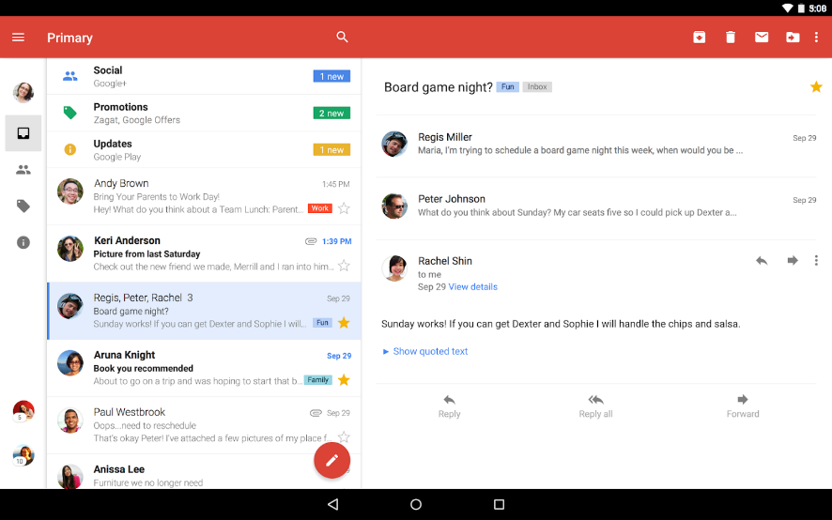
Google Mail

Slide 33
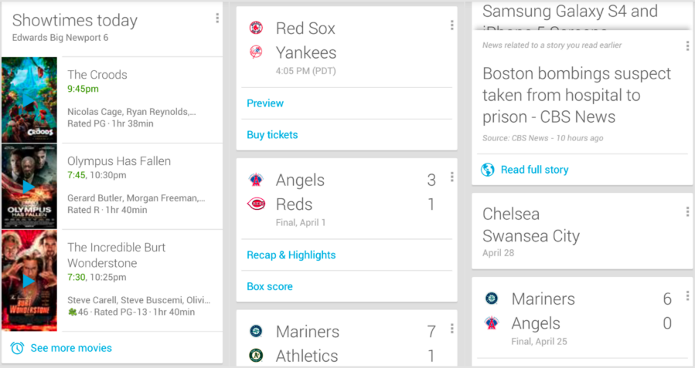
Google Now

Slide 34





Context Based Services
Machine Learning for Industrial Service
Case based Reasoning
MIO 1B3
Service-Fall
Problem
Service-Informations- System
?
MIO 9A1
Daten-Pool
MIO 84X
Gibt es vergleichbare Vorkommnisse auch in anderen Maschinen?

Slide 35







Predictive Maintenance
Predictive Maintenance
Big Data Analysis
Central Database
Predictive Maintenance
Alert
Log Data
Maintenance
Service Data
Daily operations
being logged
Expert Knowledge

Slide 36
TECO
Pervasive Computing Systems

Slide 37
Institut für Telematik
Prof. Dr. Sebastian Abeck (seit 1996)
Prof. Dr. Michael Beigl (seit 2010)
Prof. Dr. Wilfried Juling (seit 1998, Jetzt CIO des KIT)
Prof. Dr. Hannes Hartenstein (seit 2003, Geschäftsführender Direktor Steinbuch Centre for Computing)
Prof. Dr. Bernhard Neumair (seit 2010, Direktor Steinbuch Centre for Computing)
Prof. Dr. Achim Streit (seit 2010, Direktor Steinbuch Centre for Computing)
Prof. Dr. Martina Zitterbart (seit 2001) - Sprecherin
em. Prof. Dr. Gerhard Krüger (seit 1971)

Slide 38


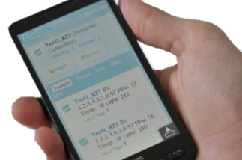
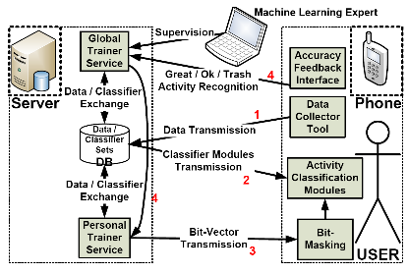
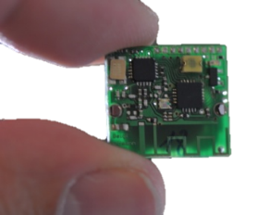
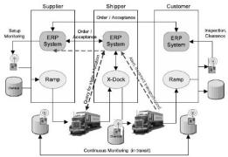
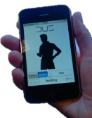

TECO
Human Computer Interaction
Communication & Systems
Sensing & Analytics
Mobile & Ubiquitous Computing

Slide 39
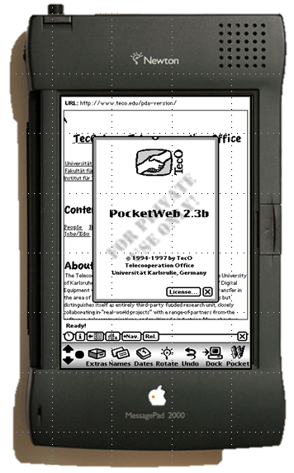
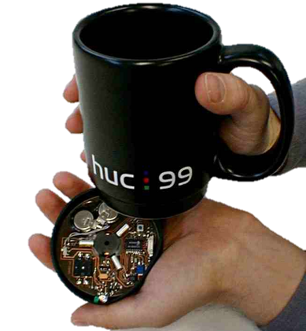
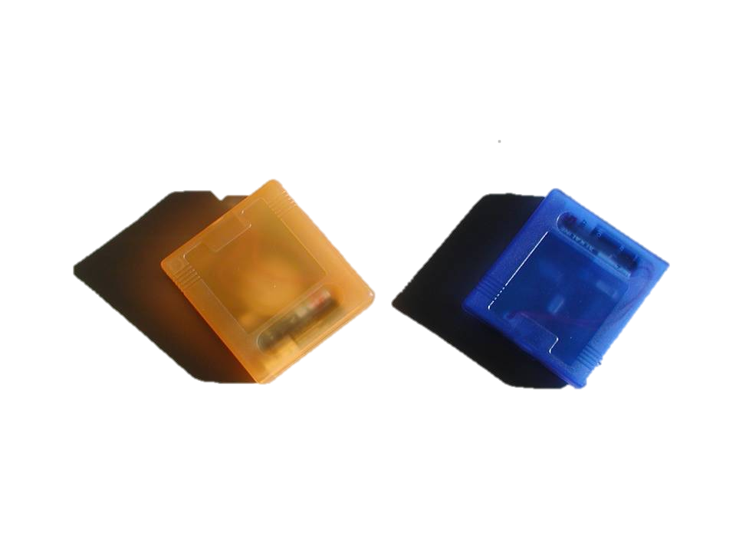
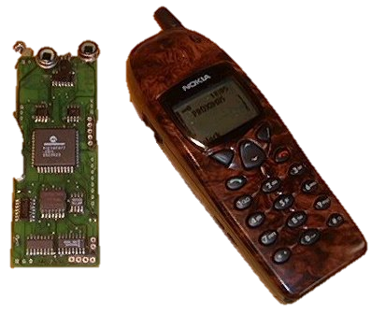
Research @
1996: First Web-Browser for a Smart Phone
1998: First Context-Aware, Sensor Enable Phone
1999: First augmented object
2000: First European Sensor-Network (Smart-Its)
2002: Novel HCI Pattern: Implicit Interaction
2005: First commercial <1cm³ sensor node (uPart/Particle)

Slide 40
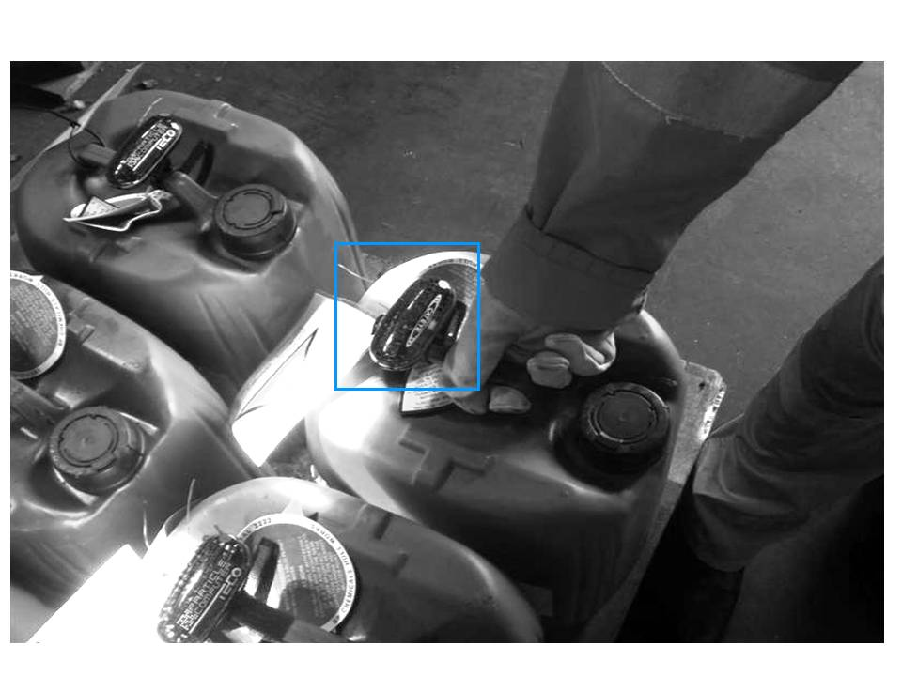


teco.kit.edu
Bridging the Gap to Reality
Sensors. Activities. Recognition. Reasoning

Slide 41
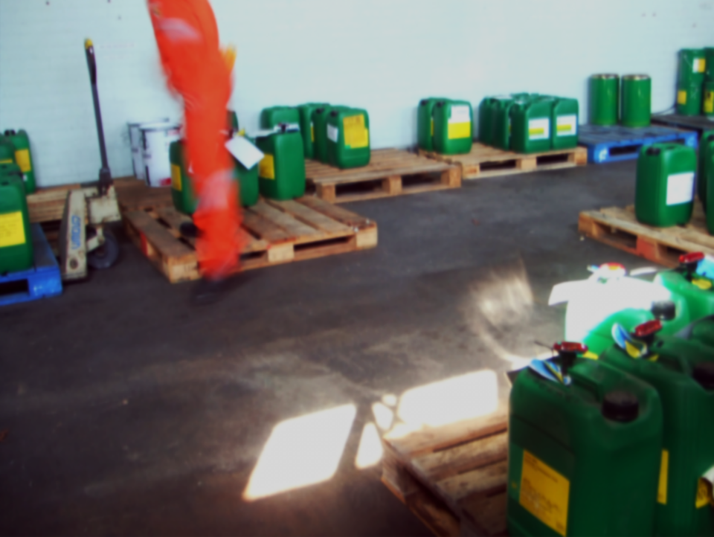
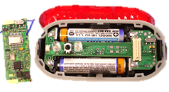
Ubiquitäre Systeme
Example: Monitoring and Reaction Storage Context (Environtal conditions, Co-Location with other chemicals,
handling,…)
Collaborative Business Items
Notes:
Ubiquitäre Systeme wie von Weiser vorgeschlagen beschreiben Paradigmenwechsel Großrechner zu Kleinstrechnern
Praktisches Beispiel: Überwachung der Lagersituation mit smart items
Sensorknoten Umgebung, tonnen
Ziel Verringerung der Diskrepanz V vs. R

Slide 42
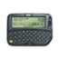



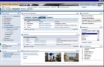
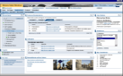

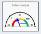






ERP Embedding (SAP)
Devices
People
roles
embedded analytics
collaboration
roles
alerts
A2A
B2B
Information
Leg- acy
SCM
ERP
PLM
EHS
SRM
CRM
PLM
P2P Net
Smart Items
Particle Sensor Network
Physical World

Slide 43


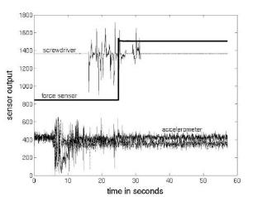
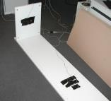
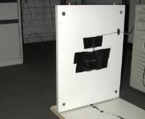

Collaboration
… Using the Particle-Computer Platform
The Particle-Computer Platform has its roots in the EU Smart-Its project (ETH Z., U. Lancaster, Play, VTT, U.Karlsruhe)
Devices and Applications (e.g. IKEA proactive furnish assembly)

Slide 44
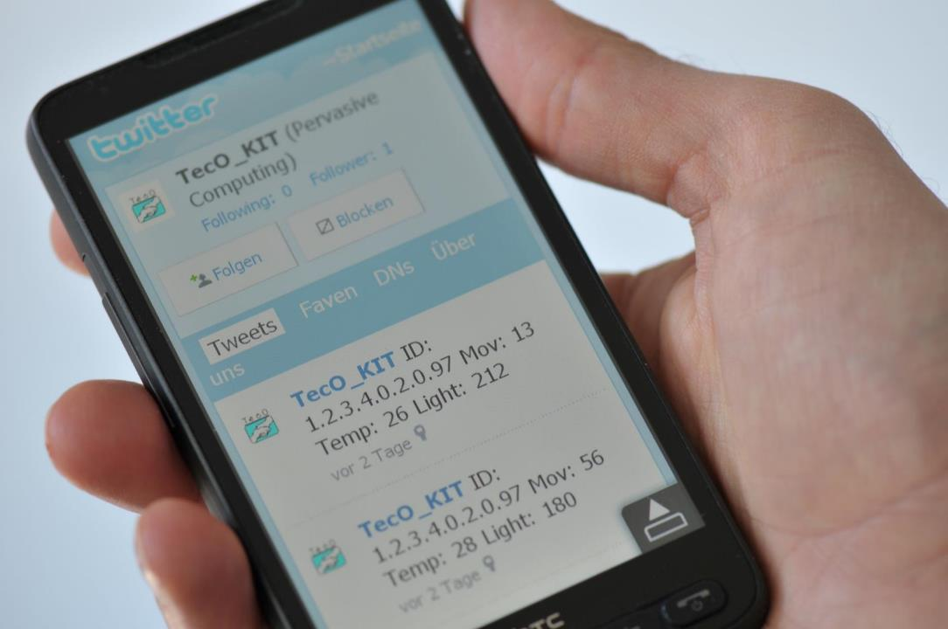
teco.kit.edu
Mobile Interaction:
Driving Factor for Context Awareness

Slide 45
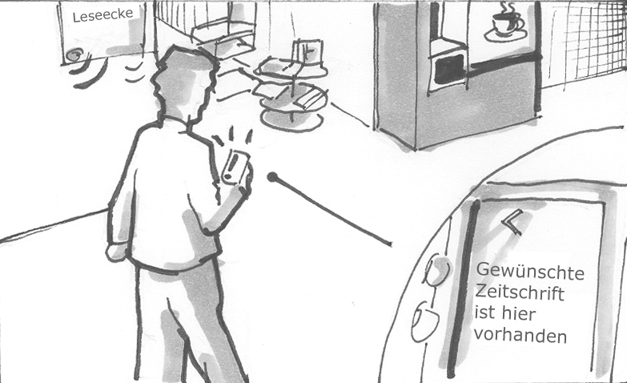
MemoClip
Notes:
Supports reminding tasks
Goal: reduce cognitive load
Based on any context, not only time
Users enter a task and link them to a context, e.g. „if you are in a supermarket take butter with you“
MemoClip is a personal device and thus always with you
Active reminder based on detected context: Rain & exit door > Umbrella
Similar usage as in electronic calendar applications
E.g. Repeated tasks, single tasks

Slide 46
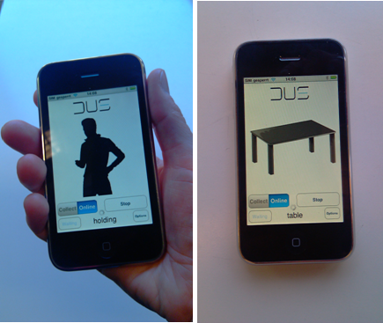
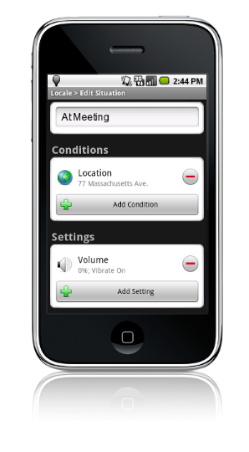
Activity Recognition for Mobile Phones
Notes:
Most of you may have guessed, it is the mobile phones again. By using their sensors, and by adding sophisticated algorithms we are able to conclude on the users condition
- We are proud here to present the first version of a high quality, user-independent activity recognition system for SmartPhones. This system called ActiPhone will also be demonstrated on our demo booth.

Slide 47
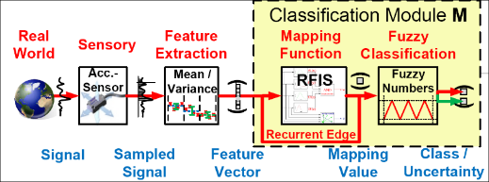
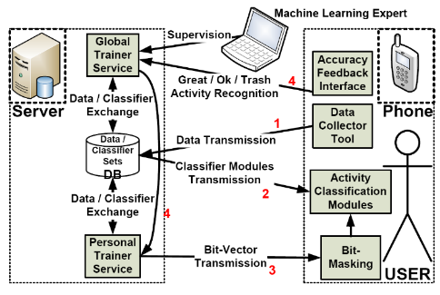
Self-Awareness Activity Reasoning in Context
Notes:
Most of you may have guessed, it is the mobile phones again. By using their sensors, and by adding sophisticated algorithms we are able to conclude on the users condition
- We are proud here to present the first version of a high quality, user-independent activity recognition system for SmartPhones. This system called ActiPhone will also be demonstrated on our demo booth.

Slide 48
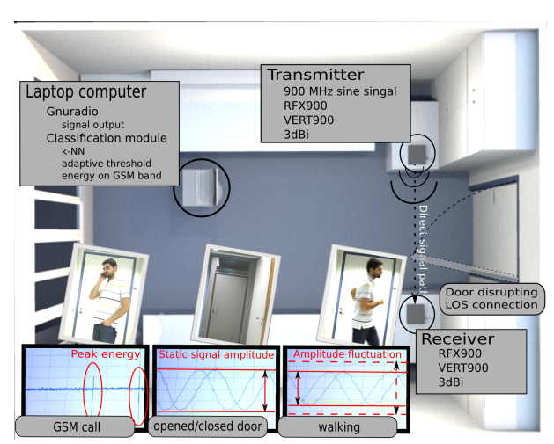
Activity Recognition Using RF Signals

Slide 49
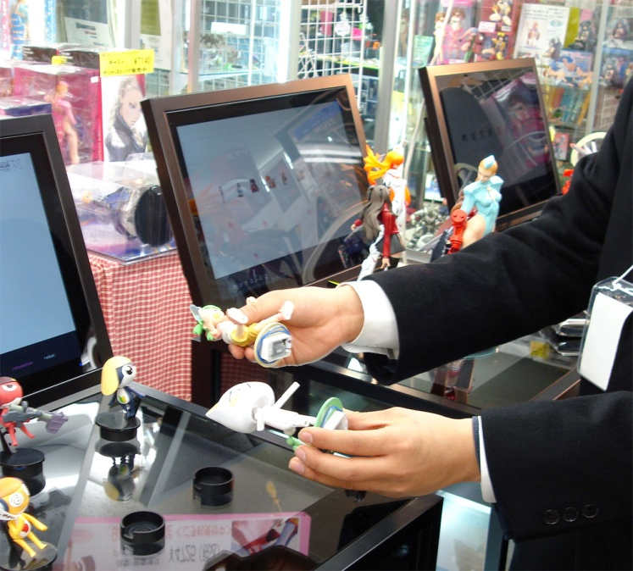
teco.kit.edu
Retail store applications

Slide 50
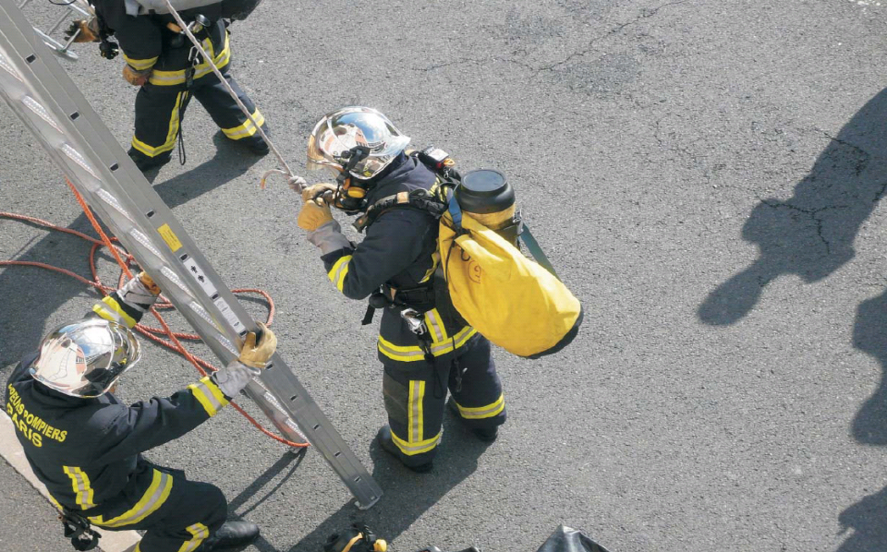
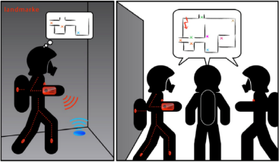
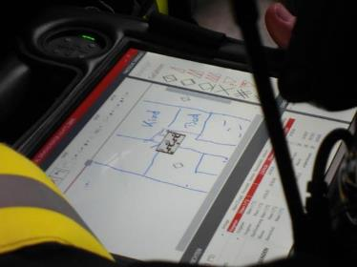
Civil Security: Supporting Firefighters with Context
Notes:
Diesen Ansatz möchte ich an einem Beispiel motivieren

Slide 51


Internet of Things and Services: Dangerous Goods Logistics
ERP System for Dangerous Goods
CoBIs project 2005-2008

Slide 52
The Agile Internet of Things and Services
Devices
People
roles
embedded analytics
collaboration
roles
User Presentation
alerts
A2A
B2B
Information
Services
Leg- acy
SCM
ERP
PLM
EHM
SRM
CRM
PLM
IoT Network
Smart Items
CUMMULUS Middleware & Transcoder
Physical World / Things

Slide 53
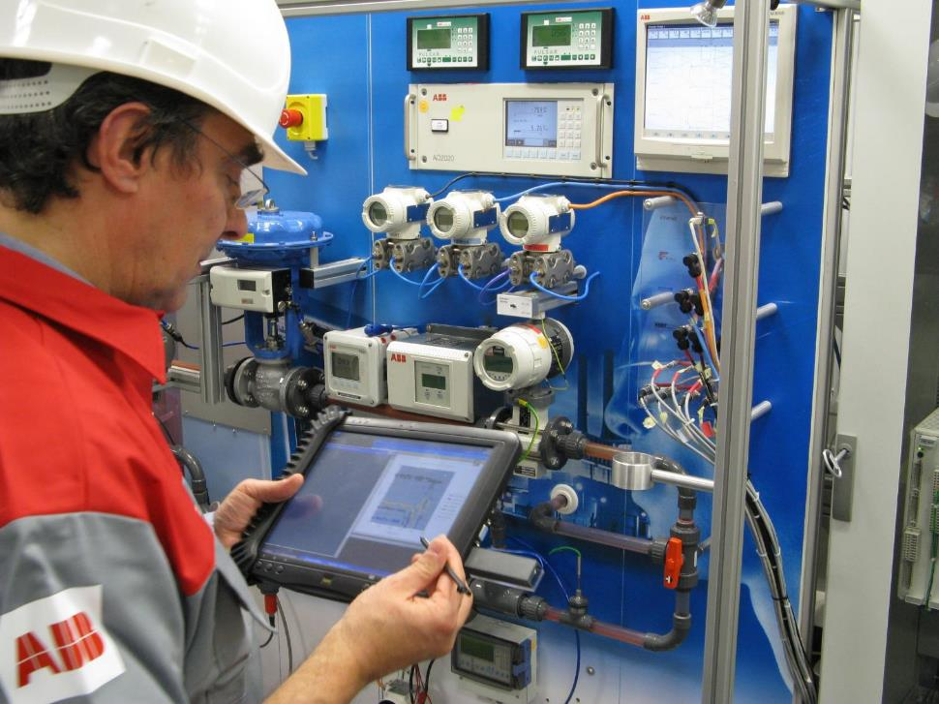
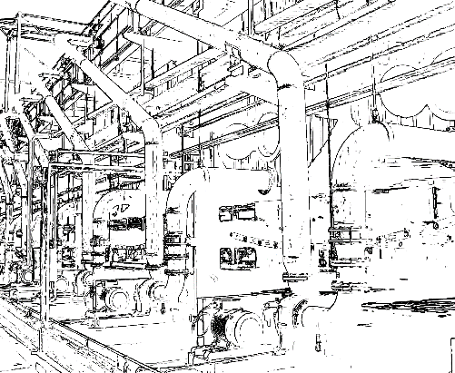
teco.kit.edu
L1A10 Temp
L3A10 Temp
L1A10 Temp
L1B22 Temp
L1B20 Temp
Information for the Shopfloor:
In-situ analytics & semantic Federation
Aletheia project, 2008-2011

Slide 54
More organisational
Notes

Slide 55
Basic Reading!!!
B. N. Schilit, N. Adams and R. Want, “Context-aware computing applications,” in Proc. Workshop on Mobile Computing Systems and Applications, IEEE, 1994, 85-90
A. K. Dey and G. D. Abowd, “Towards a better understanding of context and context-awareness,” The What, Who, Where, When, Why and How of Context-Awareness Workshop at the Conference on Human Factors in Computing Systems (CHI), 2000
G. Chen and D. Kotz, A survey of context-aware mobile computing research. Technical Report TR 2000-381, Department of Computer Science, Dartmouth College, November 2000
Dourish, Paul. "What we talk about when we talk about context." Personal and ubiquitous computing 8.1 (2004): 19-30.

Slide 56
More References used in this lecture
Want, Roy, and Andy Hopper. "Active badges and personal interactive computing objects." Consumer Electronics, IEEE Transactions on 38.1 (1992): 10-20.
Rob Semper, Exploratorium, and Mirjana Spasojevic, HP Labs, The Electronic Guidebook: Using Portable Devices and a Wireless Web-based Network to Extend the Museum Experience - Overview and Findings to Date, Museums and the Web Conference, April 2002
Rene Mayrhofer, An Architecture for Context Prediction, PhD Thesis 2004
Nivala, Annu-Maaria, and L. Tiina Sarjakoski. "Need for Context-Aware Topographic Maps in Mobile Devices." ScanGIS. 2003.
Weiser, Mark, Rich Gold, and John Seely Brown. "The origins of ubiquitous computing research at PARC in the late 1980s." IBM systems journal 38.4 (1999): 693-696.
Omar Khan Context and Context-Aware Computing, Lecture:, 2006

